Slide 1

Lecture 2 Workshops
Python Web Development: Hands-on Lab Sessions
Variables • Data Types • Operators • Conditions • Loops
Created by Mr President Abdallah Fadhili

Slide 2






WORKSHOP PHILOSOPHY & ROLES
Designed for groups of 3 to encourage discussion, shared coding, debugging, and presenting solutions.
Roles rotate every workshop!
Member 1: Driver
Member 2: Navigator
Member 3: Tester
The one who actually types the code into the computer.
Explains the logic and guides the Driver on what to write.
Finds errors, verifies output, and ensures rules are met.

Slide 3
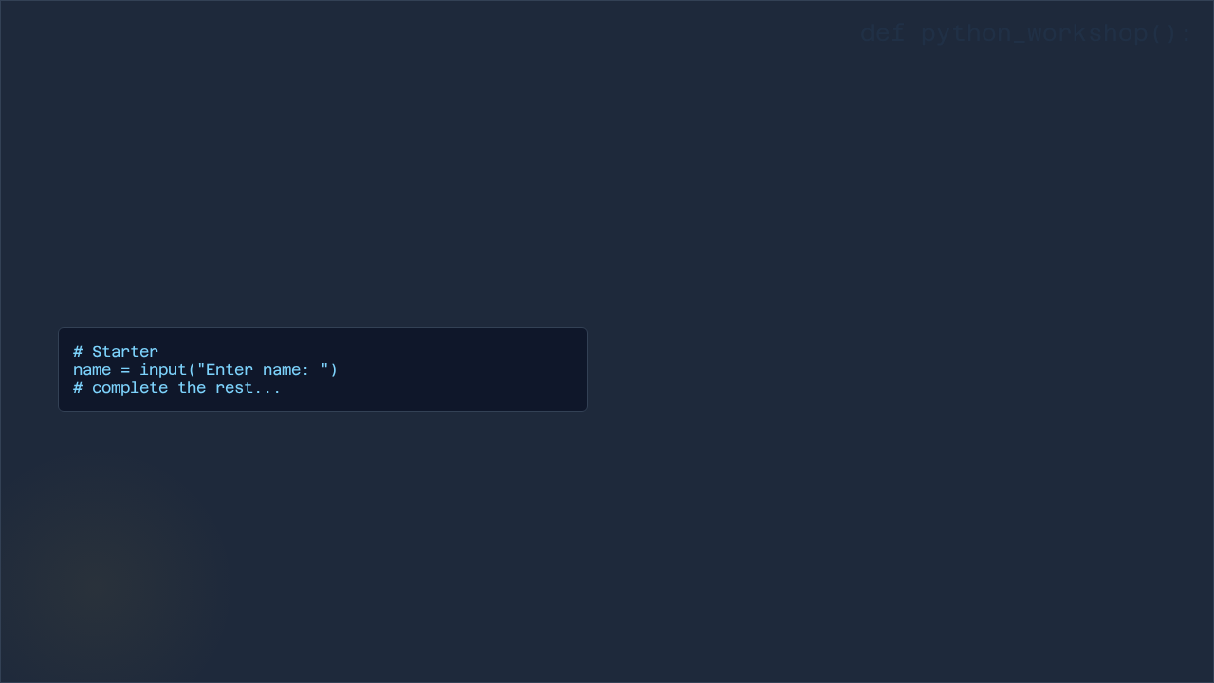


W1: STUDENT PROFILE PROGRAM
20 Minutes
Objective: Practice Inputs
>
Ask: Name, Age, Course
>
Display a formatted profile block
>
Bonus: Calculate age after 5 years

Slide 4

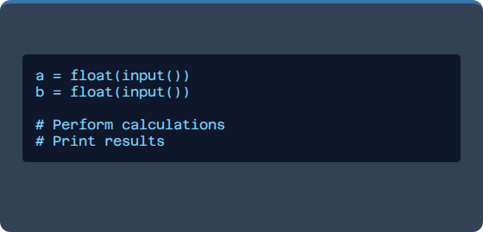
W2: SIMPLE CALCULATOR
Starter Code
Requirements
Input two numbers and calculate: Addition, Subtraction, Multiplication, Division.
Challenge: Prevent division by zero!
Example Output: Add: 15 | Subtract: 5

Slide 5

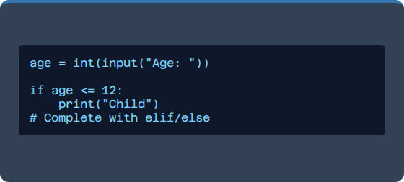
W3: AGE CHECKER
Starter Code
Logic Rules
>
0–12 → Child
>
13–19 → Teen
>
20+ → Adult
Bonus: Print if the user "Can vote" or "Cannot vote".

Slide 6


W4: STUDENT GRADE SYSTEM
The Challenge
Use if/elif/else to process the score.
Grading Scale
80–100 | Grade A
60–79 | Grade B
40–59 | Grade C
0–39 | Grade F
Validation Bonus: Reject invalid scores (must be 0–100).

Slide 7



W5: NUMBER COMPARISON
Logical Operators
Input Number A and Number B. Show:
>
Which number is Greater?
>
Are they Equal?
>
What is the Difference?

Slide 8
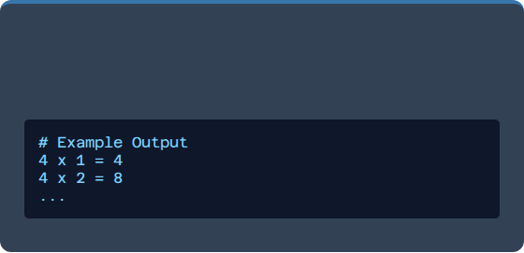
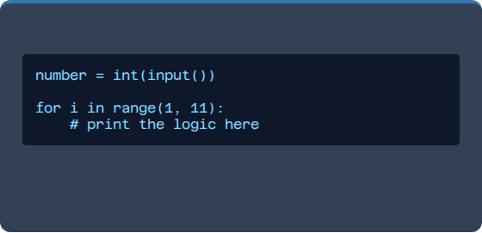
W6: MULTIPLICATION TABLE
Starter
Loop Practice
Enter a number and print its table from 1 to 10.
Bonus: Use a loop to allow the user to repeat the program.

Slide 9

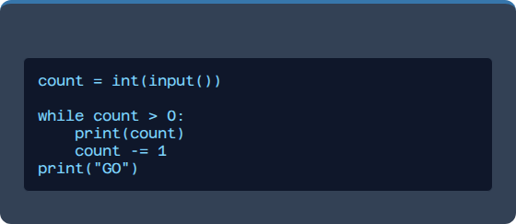
W7: COUNTDOWN TIMER
Starter
While Loop Practice
Input a starting number and count down to 1, then print "GO".
>
Bonus: Reject negative numbers as input.

Slide 10


W8: LOGIN SIMULATION
Requirements
Correct Credentials: admin / 1234
>
User gets 3 attempts.
>
Success: "Login Success"
>
Failure: "Account Locked"
Hint: Use a counter variable attempt = 0.

Slide 11

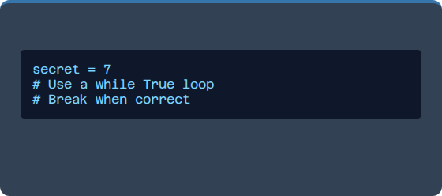
W9: GUESS NUMBER GAME
Starter
Rules
Secret Number: 7
>
Compare guess to secret.
>
Tell user: Too High, Too Low, or Correct.
>
Bonus: Count how many attempts it took.

Slide 12
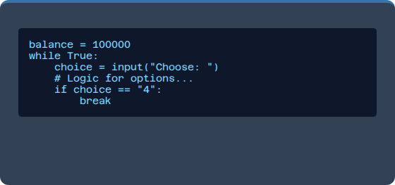
W10: MINI ATM SYSTEM
The Grand Finale
Starting Balance: 100,000
>
No negative withdrawals allowed.
>
No overdraft (cannot withdraw more than balance).
>
Infinite loop until "Exit" is selected.

Slide 13

GROUP SUBMISSION RULES
1. Assign Member Roles
>
Member A: Explain Variables
2. Deliverables
>
Full Source Code
>
Member B: Explain Conditions
>
Screenshots of working output
>
Member C: Explain Loops
>
Short explanation (3–5 lines)
Ensure every member can explain their assigned logic!

Slide 14

Happy Coding!
Any questions regarding the workshops?
Created by Mr President Abdallah Fadhili

